Slide 1




NEXT GEN EMPLOYABILITY PROGRAM
Creating a future-ready workforce
Team Members
College Name
Student Name : M.Sangara Sequvar
Student ID : au951221104040
JP College Of Engineering

Slide 2

CAPSTONE PROJECT SHOWCASE
Project Title
Voting Web Application using Django Framework
Abstract | Problem Statement | Project Overview | Proposed Solution | Technology Used | Modelling & Results | Conclusion

Slide 3
Abstract :
Title: Abstract: Development of a Voting Web Application using Django Framework
Abstract:
This paper presents the design and implementation of a web-based voting application using the Django framework. The application provides a platform for conducting various types of voting processes, including elections, surveys, and polls, in a secure and efficient manner. The system architecture is built upon Django's model-view-template (MVT) design pattern, leveraging its built-in features such as authentication, authorization, and session management for ensuring robust security.

Slide 4
Problem Statement :
Sure, here's a paragraph summarizing the key points for a voting web application built with the Django framework:
The voting web application built with Django aims to provide users with a seamless platform for participating in online polls and expressing their opinions on various topics. The application offers essential features such as user authentication for secure registration and login, poll creation functionality allowing users to create new polls with questions and multiple choices, and a robust voting system enabling users to cast their votes. Additionally, the application provides a clear display of poll results, including detailed statistics such as the total number of votes and percentages for each choice. With search and filtering options, users can easily find specific polls based on their interests or preferences. Moreover, an administration panel empowers administrators to manage polls, monitor user activity, and ensure the smooth functioning of the platform.

Slide 5
Project Overview :
The Voting Web Application using the Django Framework presents an intuitive and interactive platform for users to engage in online polls and express their opinions on diverse subjects. Central to the application is its robust user authentication system, providing a secure environment for users to register, log in, and log out at their convenience. Authenticated users gain the privilege to contribute to the platform's content by creating new polls, each comprising a question and a selection of choices. Through a streamlined voting system, users can cast their votes on existing polls, ensuring transparency and inclusivity in the decision-making process. Post-voting, users are presented with comprehensive results, detailing the distribution of votes across various choices, thereby fostering transparency and informed decision-making. The application further enhances user experience with search and filtering functionalities, empowering users to easily discover relevant polls based on their interests. For administrators, a dedicated administration panel offers comprehensive control over the platform, facilitating efficient management of polls, user activity, and overall platform performance.

Slide 6
VOTING APPLICATION :
.
• Built with a focus on user engagement and security, it ensures a
transparent and accessible voting process for all participants
• This innovative tool is designed to facilitate democratic engagement
and decision-making across diverse groups, fostering a participatory
culture in any setting.
• With Django’s built-in administration interface, you can easily
manage the polls and choices

Slide 7
Advantages :
Rapid Development: Django follows the "Don't Repeat Yourself" (DRY) principle and provides a wide range of built-in functionalities such as user authentication, admin interface, and ORM, enabling developers to build applications quickly with less boilerplate code.
Scalability: Django's architecture is designed to handle high levels of traffic and scale seamlessly. It offers built-in support for caching, database pooling, and asynchronous task execution, allowing applications to handle large volumes of users and data efficiently.
Community and Documentation: Django has a large and active community of developers who contribute to its development and provide support through forums, mailing lists, and documentation. The official Django documentation is comprehensive and well-maintained, making it easy for developers to learn and troubleshoot issues.

Slide 8
Disadvantages :
Learning Curve: Django has a steep learning curve, especially for beginners with limited experience in web development or Python programming. Developers may require time to grasp the framework's concepts and conventions.
Opinionated Framework: Django follows the "Django way" of doing things, which can be restrictive for developers who prefer more flexibility and freedom in their frameworks. This could lead to challenges when implementing custom or unconventional features.
Customization Limitations: While Django provides many built-in features, customization beyond its defaults can be challenging and may require diving into the framework's internals. This could pose difficulties when implementing highly specialized or unique requirements.
Performance: While Django is scalable and capable of handling high levels of traffic, it may not be as performant as some other frameworks for certain types of applications. Developers may need to optimize their Django applications for performance, especially when dealing with large datasets or complex business logic.

Slide 9




Technology Used
Front-end
Back-end

Slide 10
Modelling & Results :
In the voting web application developed using the Django framework, the data model encompasses entities such as Users, Voting Events, Ballots, Candidates, and Votes. Users register and authenticate securely, gaining access to active voting events where they can cast their votes on customizable ballots featuring various voting methods. Real-time result updates are provided, displaying the current status of the voting process and the accumulated votes for each candidate. The application implements stringent security measures to protect the integrity of the voting process, including encryption techniques and authentication mechanisms. Through Django's built-in admin interface, administrators can manage voting events, candidates, and user accounts efficiently. Overall, the voting web application provides a reliable, user-friendly, and transparent platform for facilitating democratic decision-making processes.

Slide 11
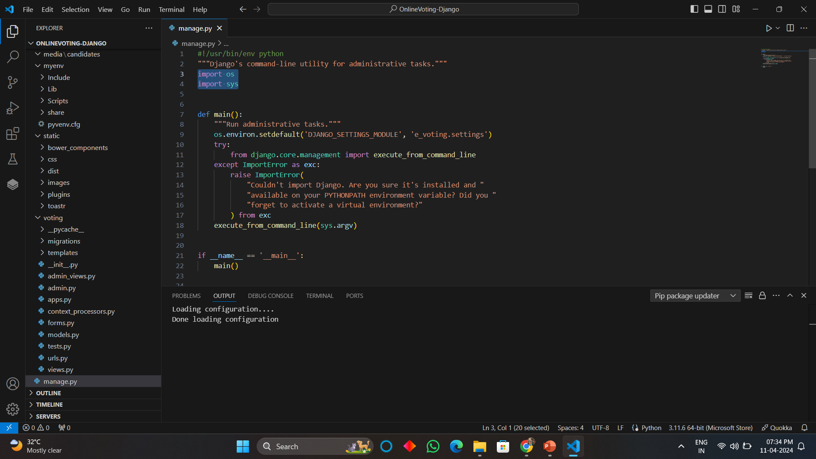
Homepage

Slide 12
About-Us-Page
1.Credibility:
The "About Us" page establishes credibility by providing information about the organization's history, mission, and team members
2.Mission and Values:
It communicates the organization's mission, values, and objectives in promoting democratic participation and decision-making.
3. Community Engagement:
The page showcases the organization's commitment to community engagement and empowerment through the voting process, inspiring active participation.
4. Contact Information:
Users can easily reach out with questions, feedback, or inquiries about the voting application through the contact information provided on the page.

Slide 13
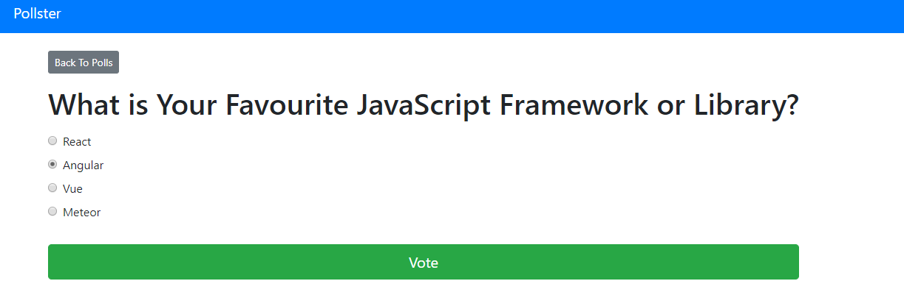
Blog-Page

Slide 14
Future Enhancements:
For future enhancements, the voting web application built on the Django framework could incorporate advanced features such as blockchain-based voting for enhanced security and transparency, integration with biometric authentication systems for secure user verification, and support for mobile voting applications to increase accessibility and participation. Additionally, implementing machine learning algorithms could improve the accuracy of result predictions and identify potential anomalies or irregularities in voting patterns. Furthermore, enhancing the user interface with interactive data visualization tools could provide users with deeper insights into voting trends and results. Overall, these enhancements would further elevate the voting web application's capabilities, ensuring its effectiveness, security, and inclusivity in democratic decision-making processes.

Slide 15
Conclusion :
In conclusion, the Voting Web Application developed with the Django Framework stands as a testament to the power of modern technology in fostering democratic engagement and facilitating informed decision-making. Through its user-friendly interface and robust features, the application empowers users to actively participate in online polls, express their opinions on a multitude of topics, and contribute to meaningful discussions. The seamless integration of Django's versatile framework ensures scalability, security, and efficiency, guaranteeing a smooth user experience and reliable platform performance. By providing transparent voting mechanisms, comprehensive result displays, and intuitive search functionalities, the application fosters a sense of community and inclusivity, encouraging users to explore, engage, and collaborate. As technology continues to evolve, the Voting Web Application remains dedicated to promoting democratic values, facilitating dialogue, and empowering individuals to make their voices heard in an increasingly interconnected world.

Slide 16
Thank You!
Notes:
Thank You !!

